Slide 1
Working Progress
21.11.17

Slide 2
Last week:
Worked on Python script
Air flow visualisations with Inkscape
Simple evap model with EES
Achieved good values again. (open ceiling and 25pct fp)
48h tests over the weekend (25pct vs 27pct fan power)

Slide 3
Compressor weight

Slide 4
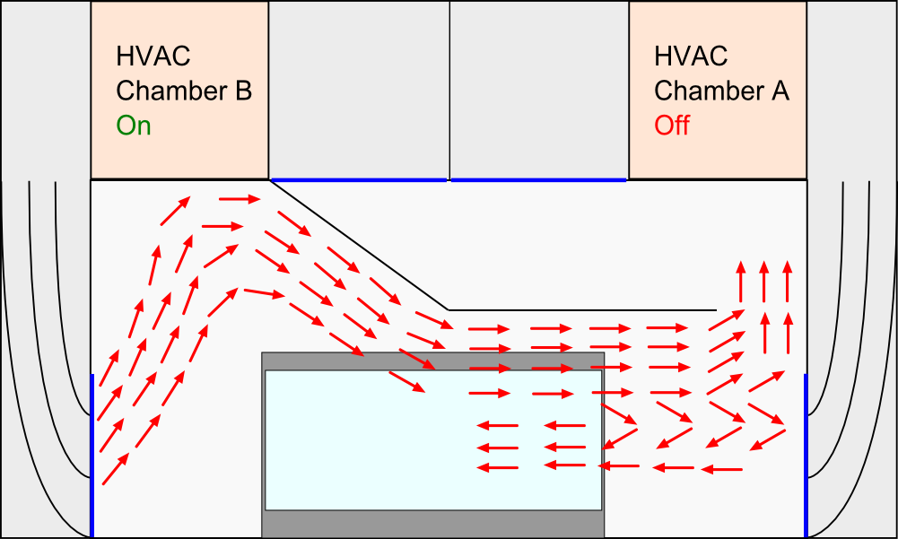
Air flow (Tests 0-37 & 45-47)

Slide 5
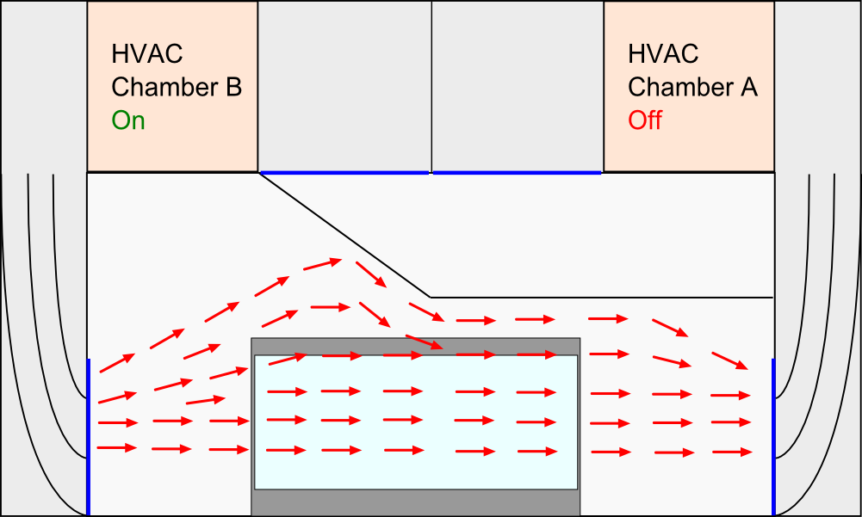
Air flow (Tests 38-44 → 5 fans – 10pct )

Slide 6
Test 40
T_cond: 35°C
T_defr: 4h
Fan Settings: 5 fans 10pct
(closed ceiling)

Slide 7
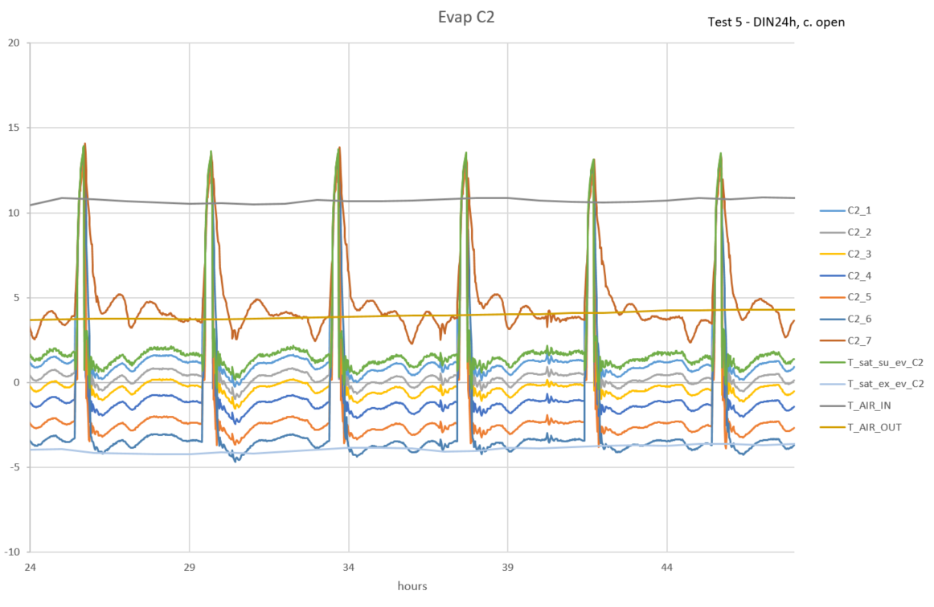
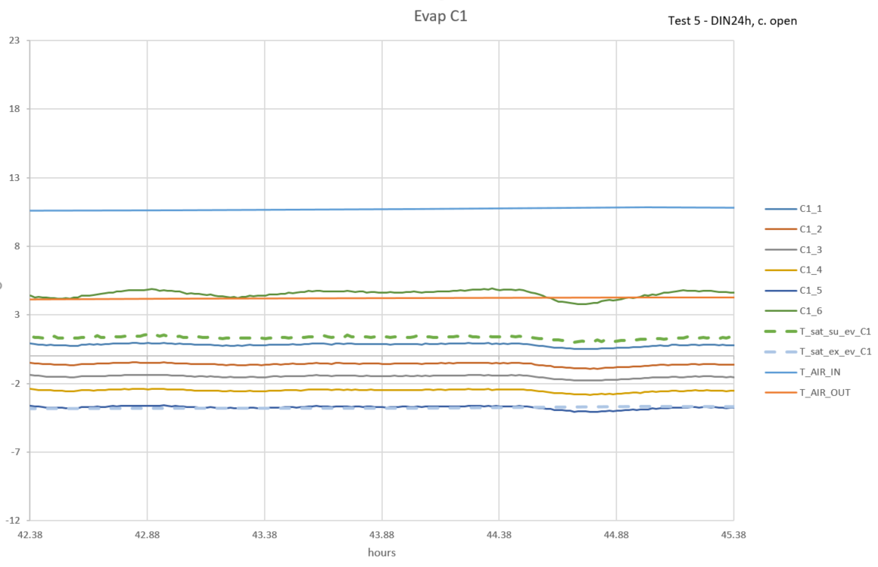
Previous testing (Test 40)
after changing back to HATCOL
Evaporating temperature looked like this:

Slide 8
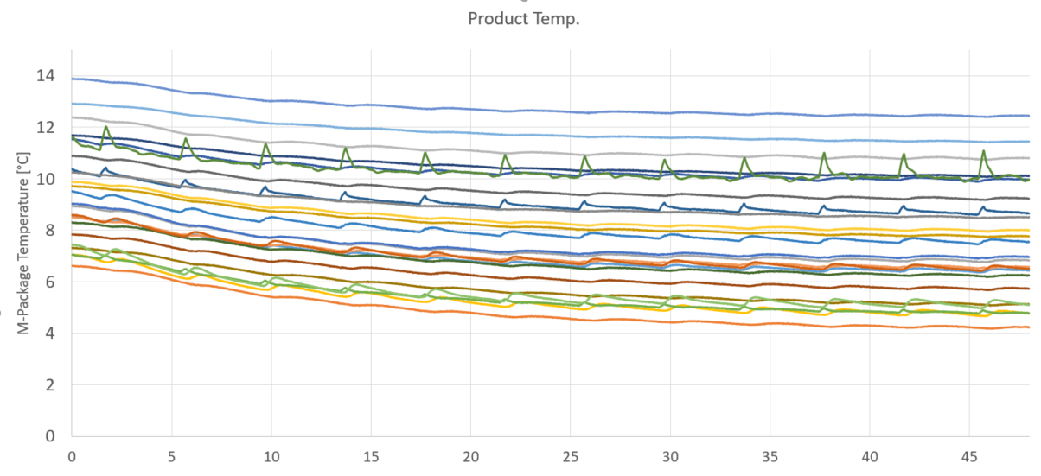
Product temperature:

Slide 9
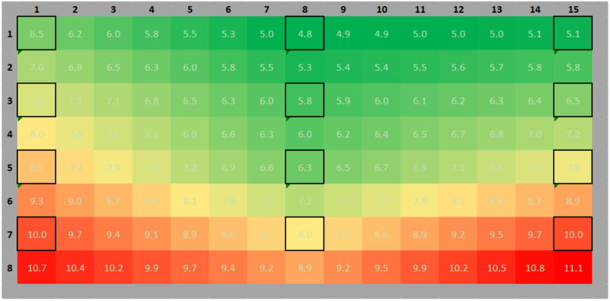
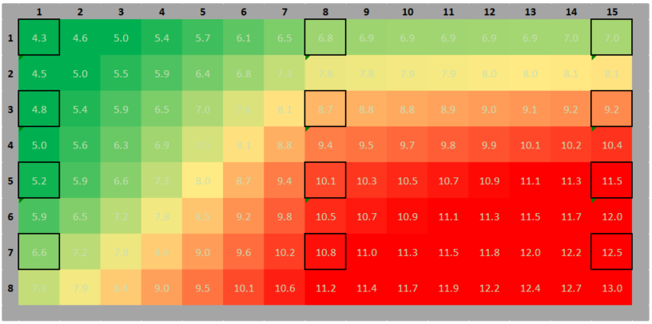
Front:
Back:

Slide 10
Possible Reasons
Too much oil in the system? (Oil stuck in condenser? Mixture HATCOL-3MAF?)
Lower air velocity → Chamber regulation is worse
higher temperature gradient in height
higher humidity oscillating → more dehumidifying?
More air streaming in front of the cabinet →more warm air is sucked in by the air curtain?

Slide 11
Test 47
T_cond: 35°C
T_defr: 4h
Fan Settings: 2 fans 25pct
(ceiling opened again)

Slide 12
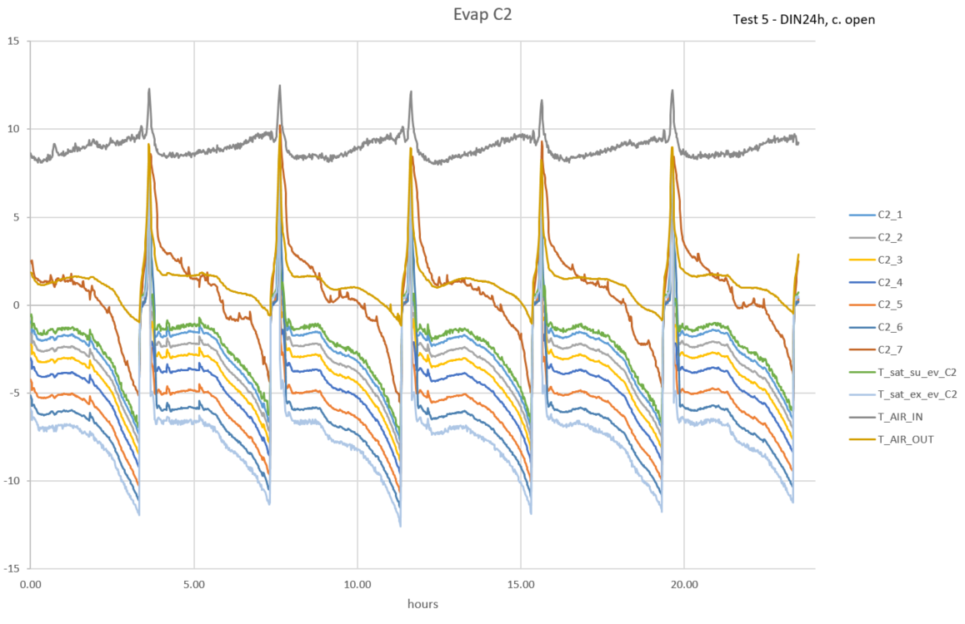
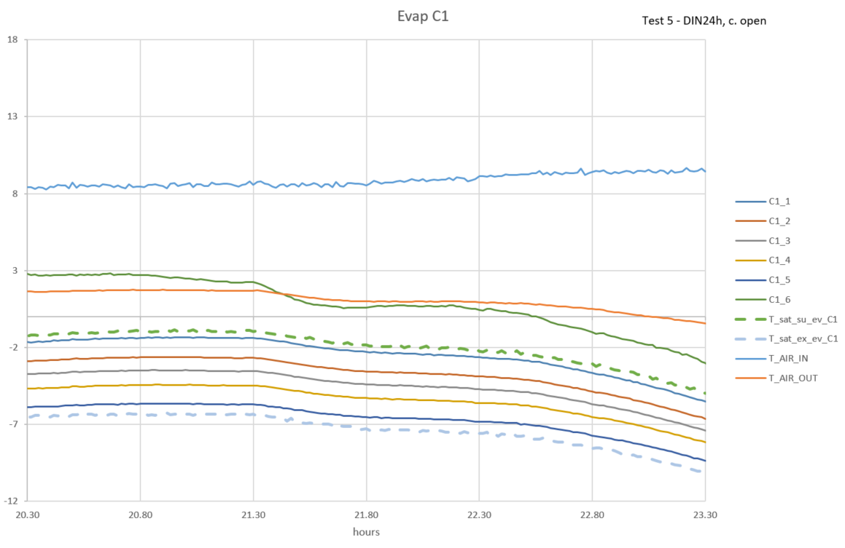
Latest Test (Test 47)
Evaporating temperature:

Slide 13
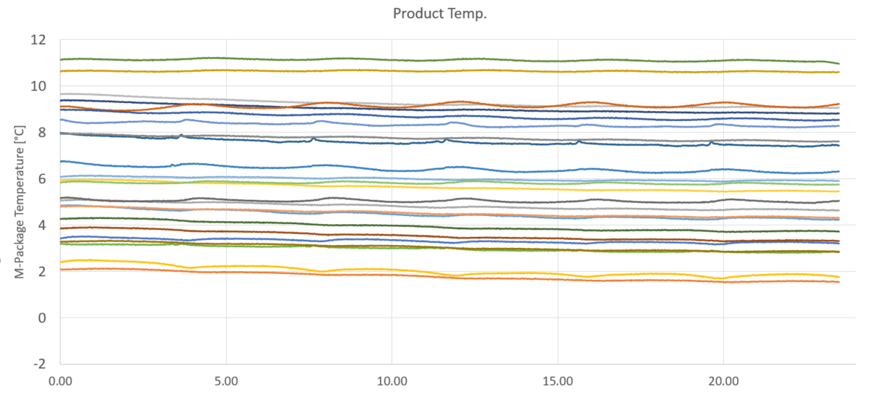
Product temperature:

Slide 14
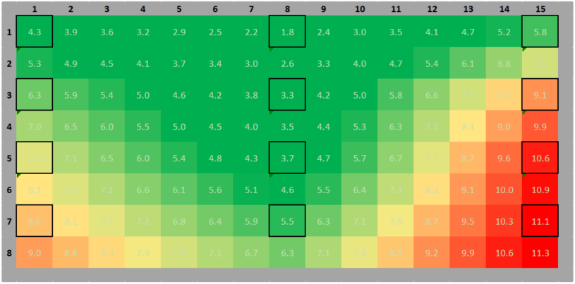
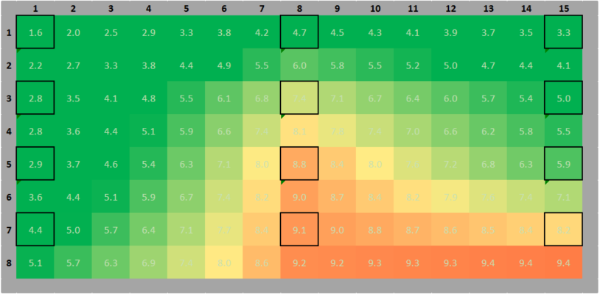
Front:
Back:

Slide 15
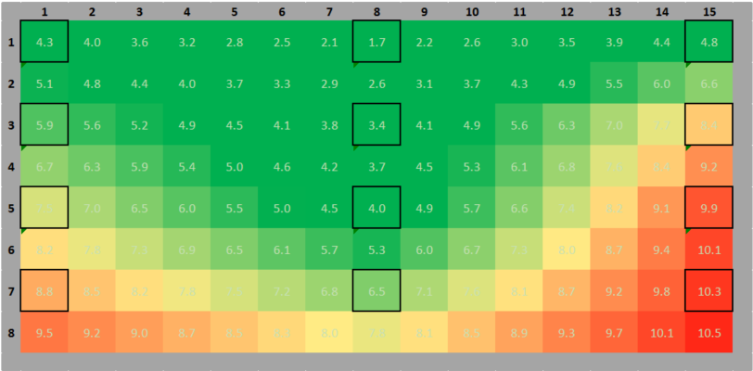
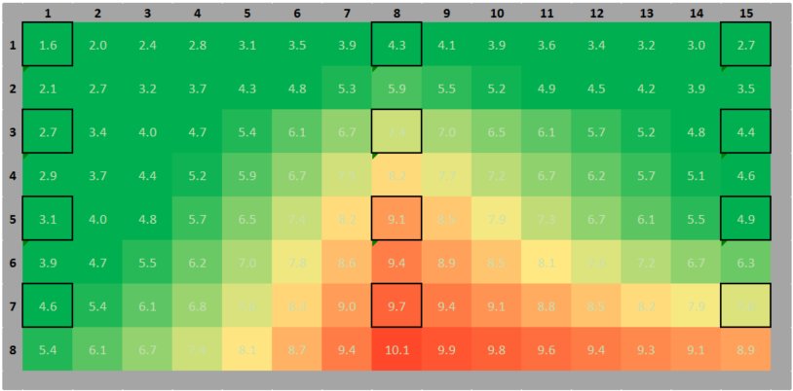
Comparison: Test 47 – Test 24
Almost good! Next results on Tuesday!

Slide 16
Next steps

